Slide 1
Pathophysiology of Cancer in Patients with Obesity
Francesco Saverio Papadia, MD, FACS, FEBS (SurgOnc)
Department of Surgical Sciences and Integrated Diagnostics DISC
University of Genoa, Italy

Slide 2
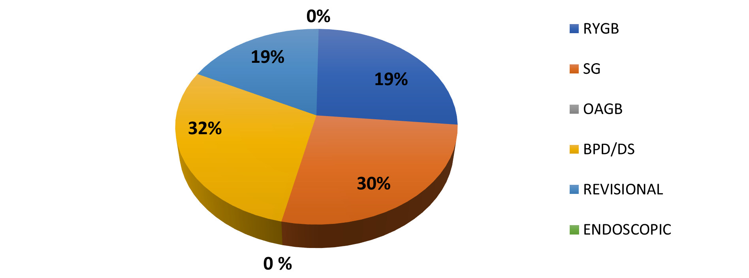
Case mix disclosure
No financial conflict of interest to disclose

Slide 4
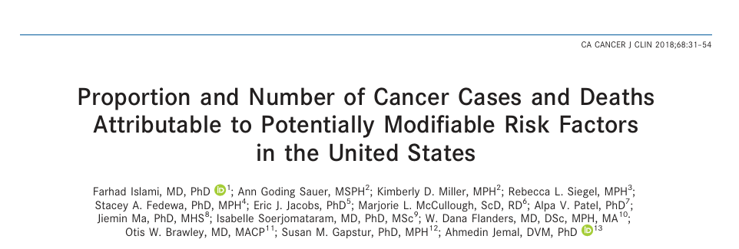
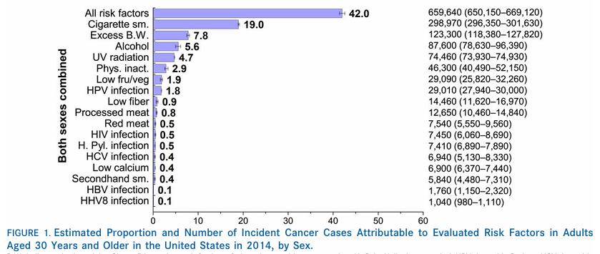

Slide 5
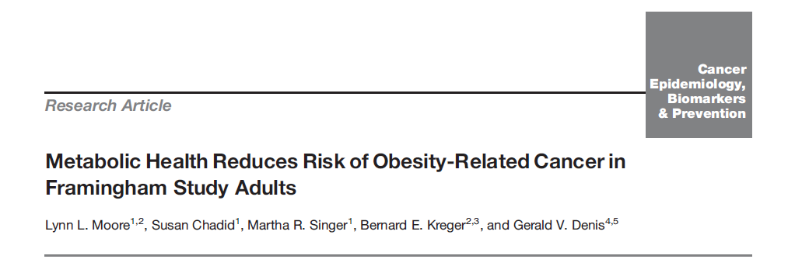
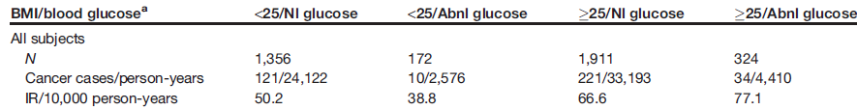
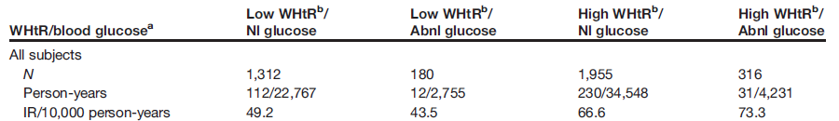

Slide 6
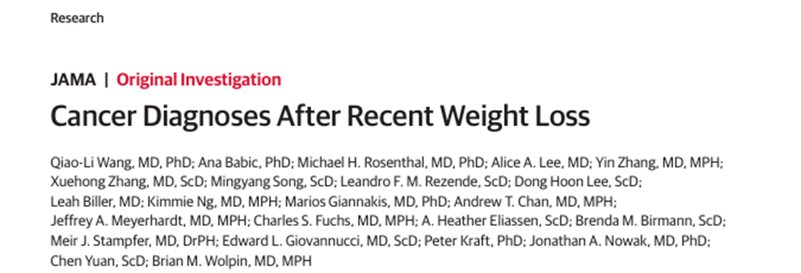

Slide 7
Paradoxical Association Between Obesity, Cancer Risk, and Mortality
Obesity is associated with a reduced risk of breast cancer (BC) in premenopausal women, non-small cell lung cancer (NSCLC), and head and neck cancers (IARC working group), while it is associated with better survival in NSCLC, renal carcinoma, and metastatic colorectal cancer (mCRC).
Possible explanations for this paradoxical phenomenon in oncology patients may include:
Inadequacy of BMI as a measure of overall adiposity
Selection, stratification, and diagnostic biases in studies
Confounding factors such as age, smoking, and physical activity
Reverse causality – cancer cachexia, and increased nutritional reserves in advanced cases

Slide 8
Biological Mechanisms of Obesity-Cancer
Hyperinsulinemia/Insulin Resistance (IR) and alterations in the insulin-like growth factor-I (IGF-I) system
Synthesis and metabolism of steroid sex hormones
Chronic subclinical inflammation and oxidative stress
Alterations in the microenvironment/extracellular matrix
Microbiome changes

Slide 9
Microbiome alteration
↓ Adiponectin production
↑ intestinal leakage/translocation, chronic inflammation
Chronic subclinical inflammation
↑ IR, chronic inflammation, steroid substrates
↑ pro-inflammatoriy cytochines, oxidative stress, IR
High intake of saturated fats
Altered steroid metabolism
Insulin resistance – diabetes
Changes in extracellular matrix and microenvironment
↑ estrogens→ endometrium,
breast (post-menopausal)
↑ Angiogenesis, chronic inflammation, oxidative stress
↑ IGF, insulin, IGFR, mTOR
Promotion
progression

Slide 10
Biological Mechanisms of Obesity-Cancer – 1
Hyperinsulinemia / Insulin Resistance (IR) and alterations of the insulin-like growth factor-I (IGF-I) system
Direct effect through mTOR pathway activation via insulin receptors
Increased oxidative stress and chronic inflammation in IR
Antitumor effect of metformin!

Slide 11
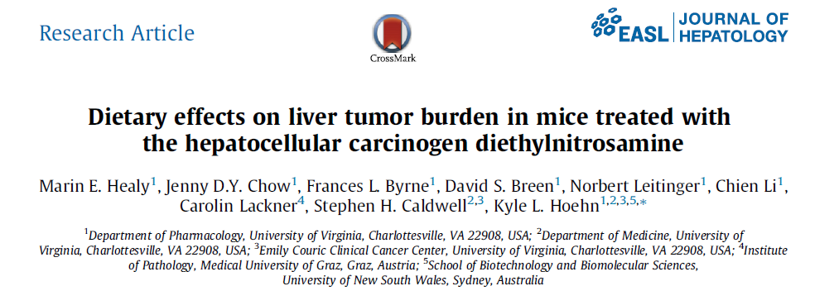
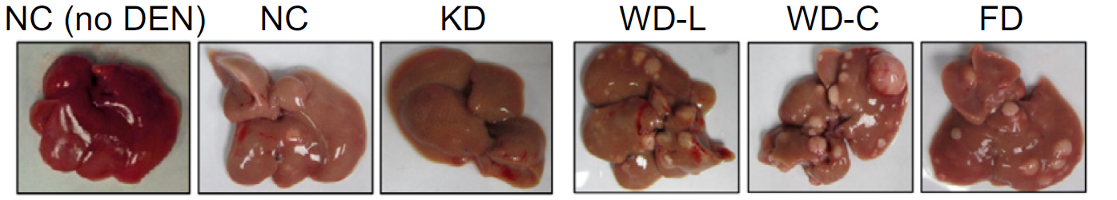
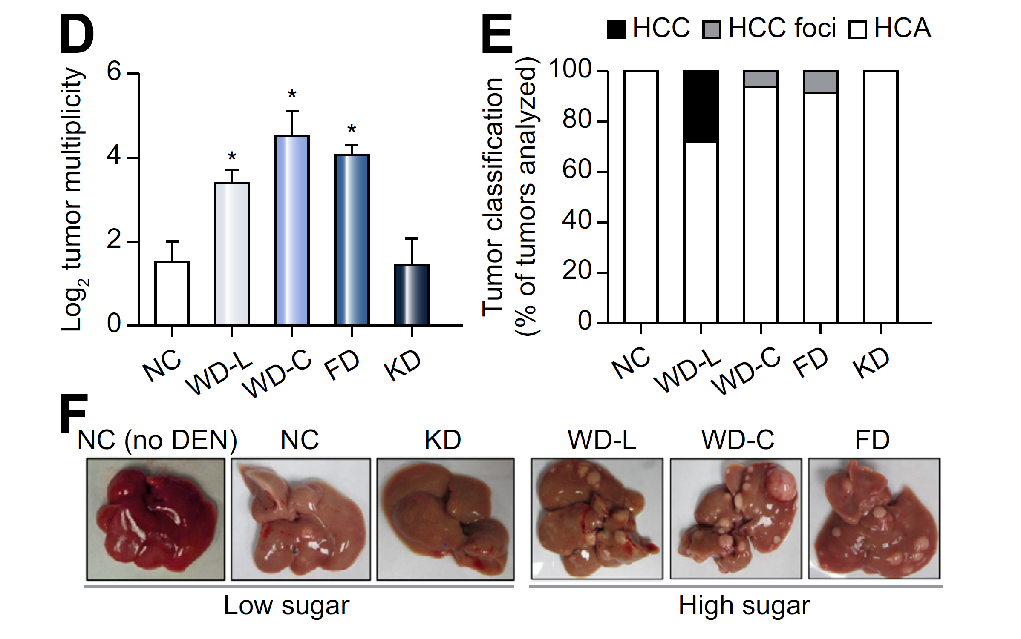

Slide 12
Biological Mechanisms of Obesity-Cancer – 2
Steroid/Sex Hormone Biosynthesis
Increased steroid hormone concentrations and decreased sex hormone-binding globulin (SHBG) are associated with increased breast cancer risk in postmenopausal women, especially for hormone receptor-positive (ER+/PR+) subtypes.
Estrogens promote tumorigenesis in endometrial tissue by stimulating cell proliferation and inhibiting apoptosis.
Controversial role for androgens in prostate cancer:
i) No clear correlation between steroid levels and cancer risk
ii) Obese males tend to have lower testosterone levels
iii) Low testosterone is associated with more aggressive prostate cancer subtypes

Slide 15
Biological Mechanisms of Obesity-Cancer – 3
Chronic Subclinical Inflammation and Oxidative Stress
Adiponectin is inversely correlated with inflammatory cytokines, which are elevated in obesity (TNF-α and IL-6); adiponectin reduces activation of NF-kB.
Leptin correlates positively with BMI and adipose tissue; it exerts pro-inflammatory effects, increasing IL-1, IL-6, IL-12, TNF-α, LTB4, and COX2.
Leptin also promotes T and TH1 cell proliferation, and inhibits Tregs.
Antitumor and anti-obesity effects of some drugs:
→ Metformin!
→ NSAIDs → reduced risk of colorectal cancer (CRC)
Causal relationship between obesity and IR, which promotes chronic inflammation
Inflammatory adipocytokines affect steroid hormone synthesis and thereby influence tumorigenesis

Slide 16
Biological Mechanisms of Obesity-Cancer – 4
Microenvironment Alterations
Peritumoral adipocytes promote tumor growth. In breast cancer, they acquire a fibroblast-like phenotype associated with greater invasiveness through production of proteases and cytokines.
In ovarian cancer, cancer-associated adipocytes (CAAs) in the omentum increase migration and invasion capacity.
Epithelial-mesenchymal transition (EMT) occurs through interaction with the extracellular matrix, leading to reduced cell adhesion and increased motility – this is promoted by weight gain and reduced with caloric restriction.

Slide 17
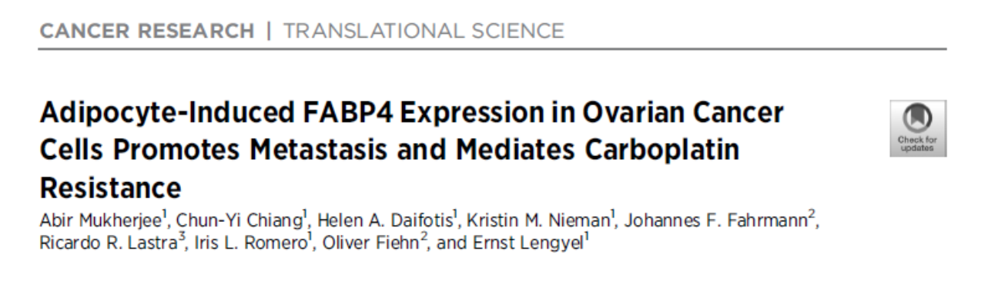

Slide 18
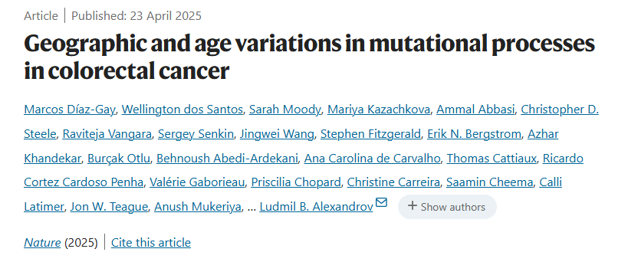

Slide 19
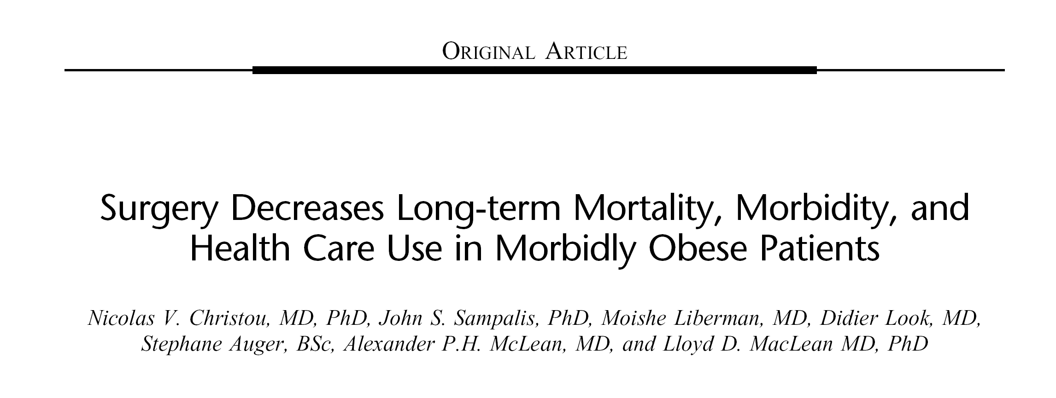
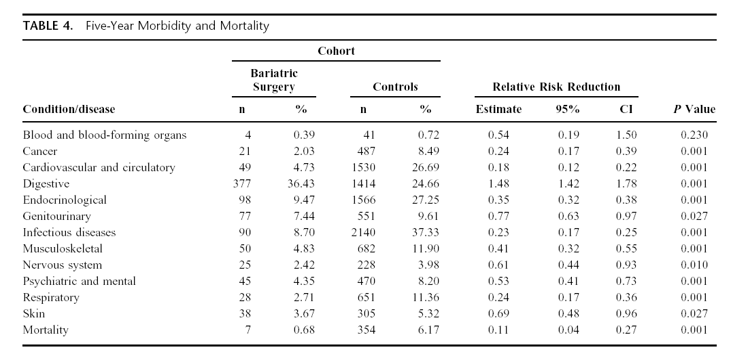
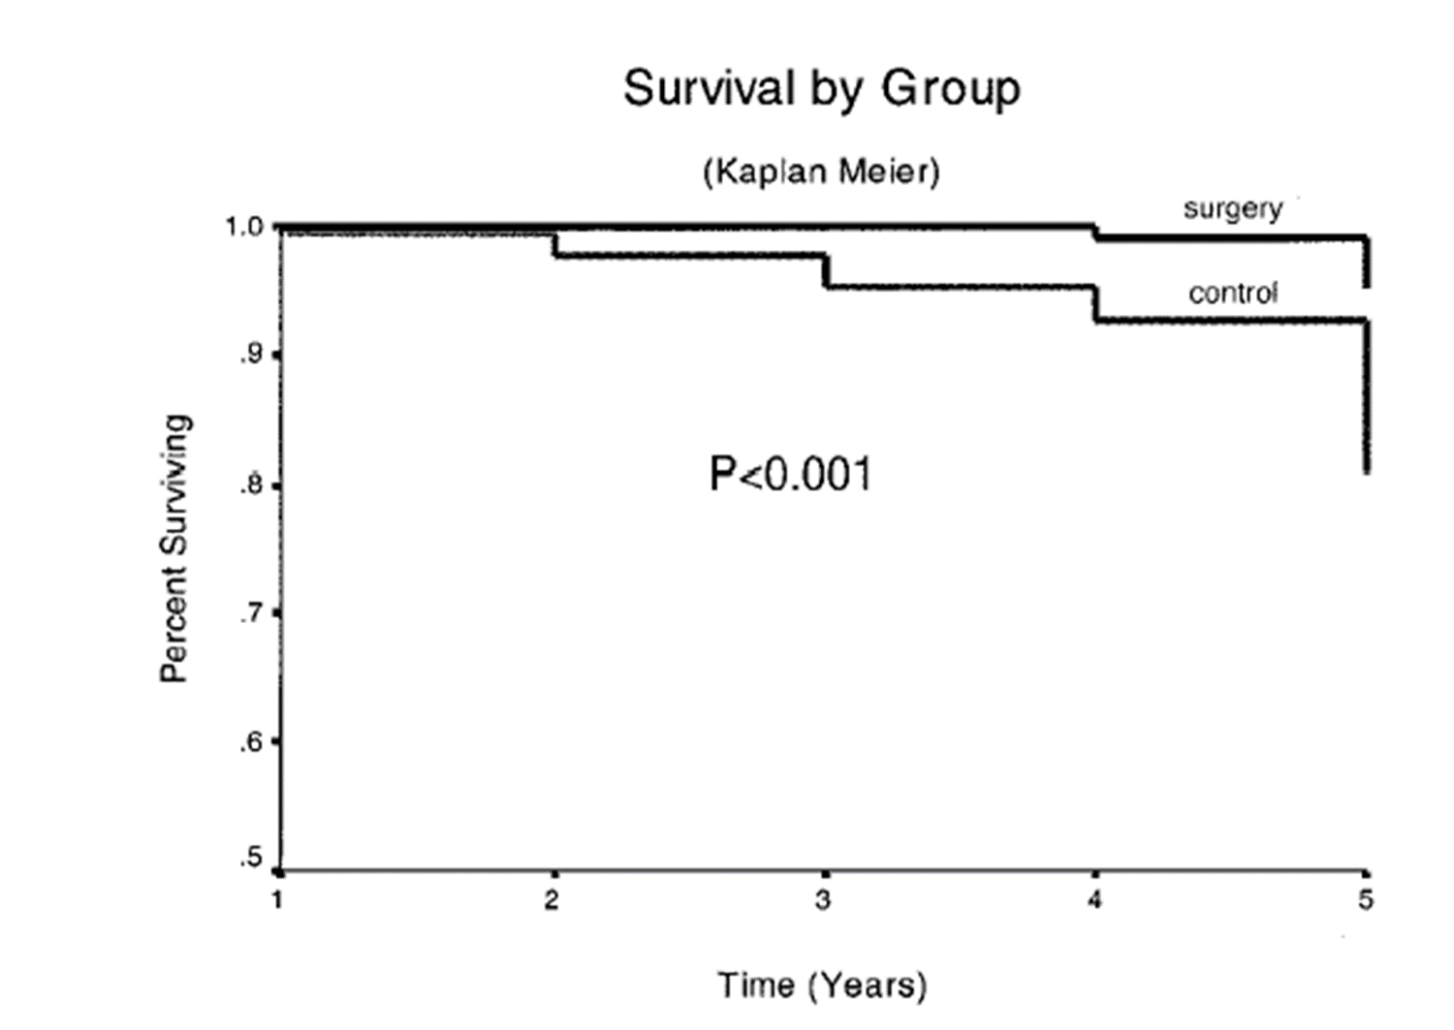

Slide 20
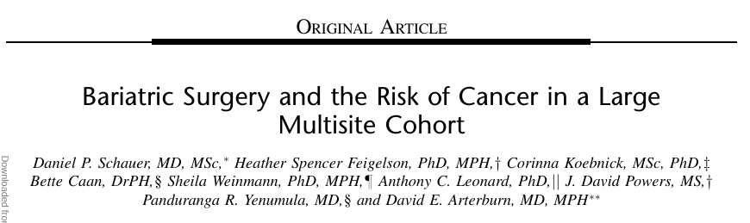

Slide 21
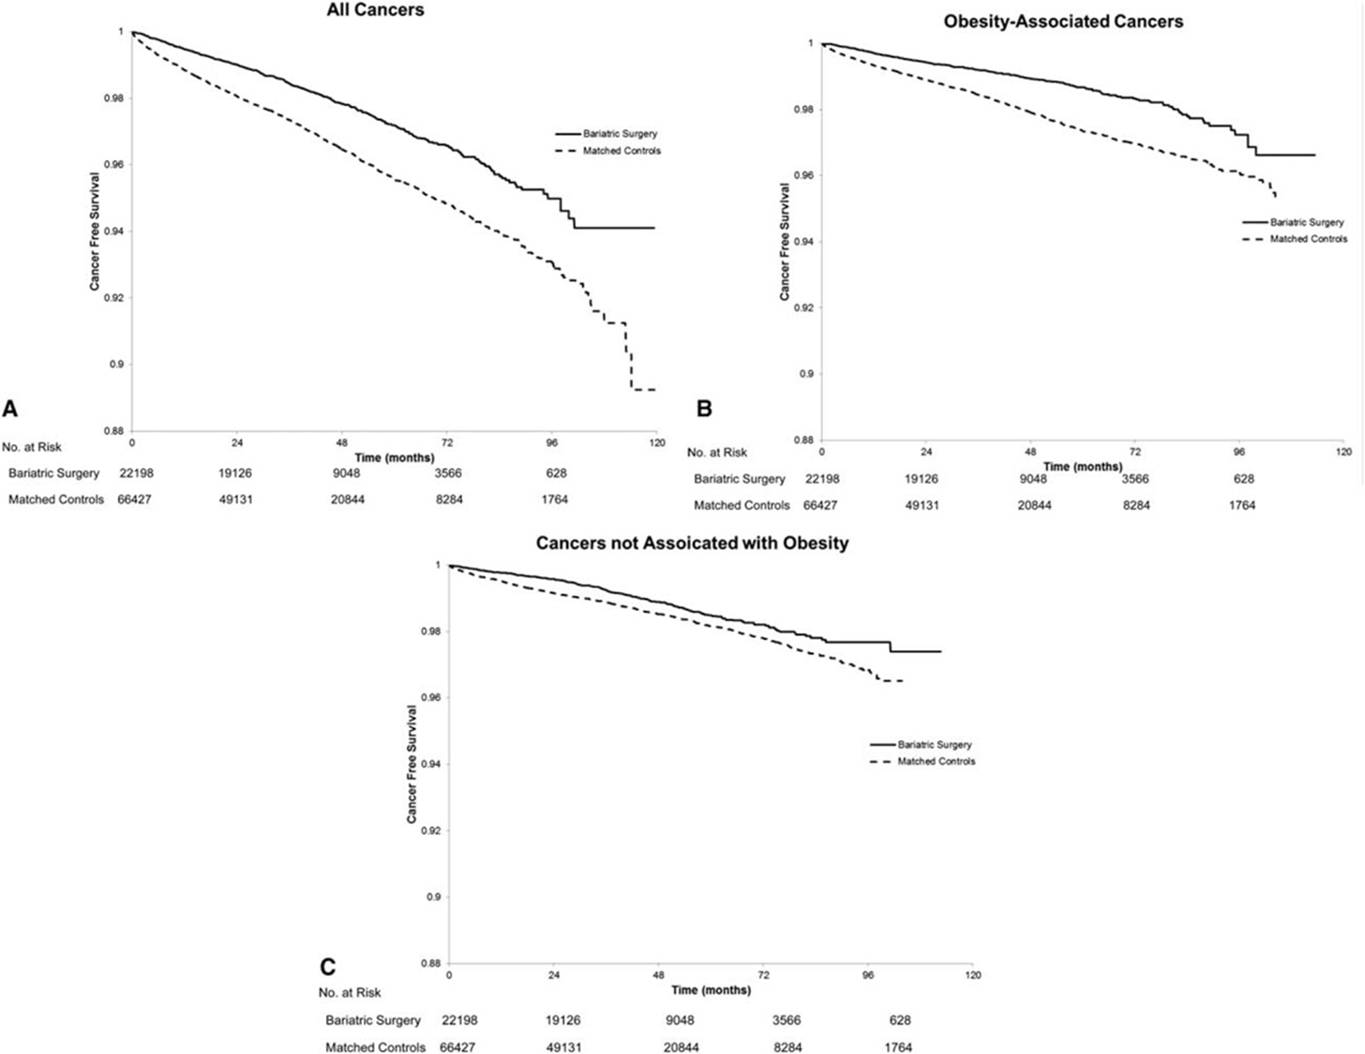

Slide 22
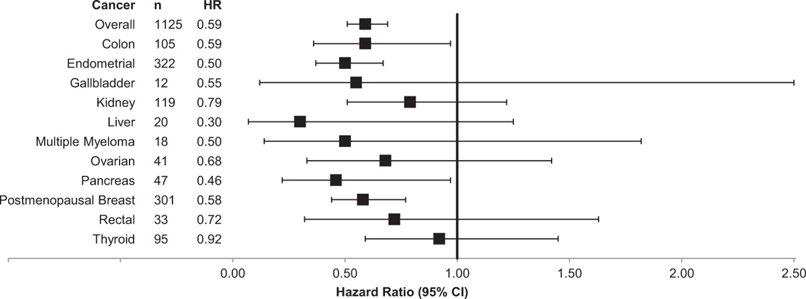

Slide 23
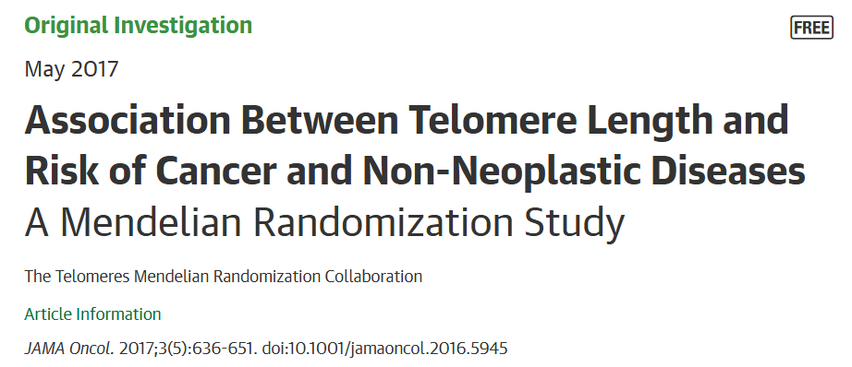
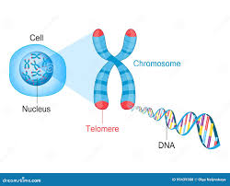

Slide 24
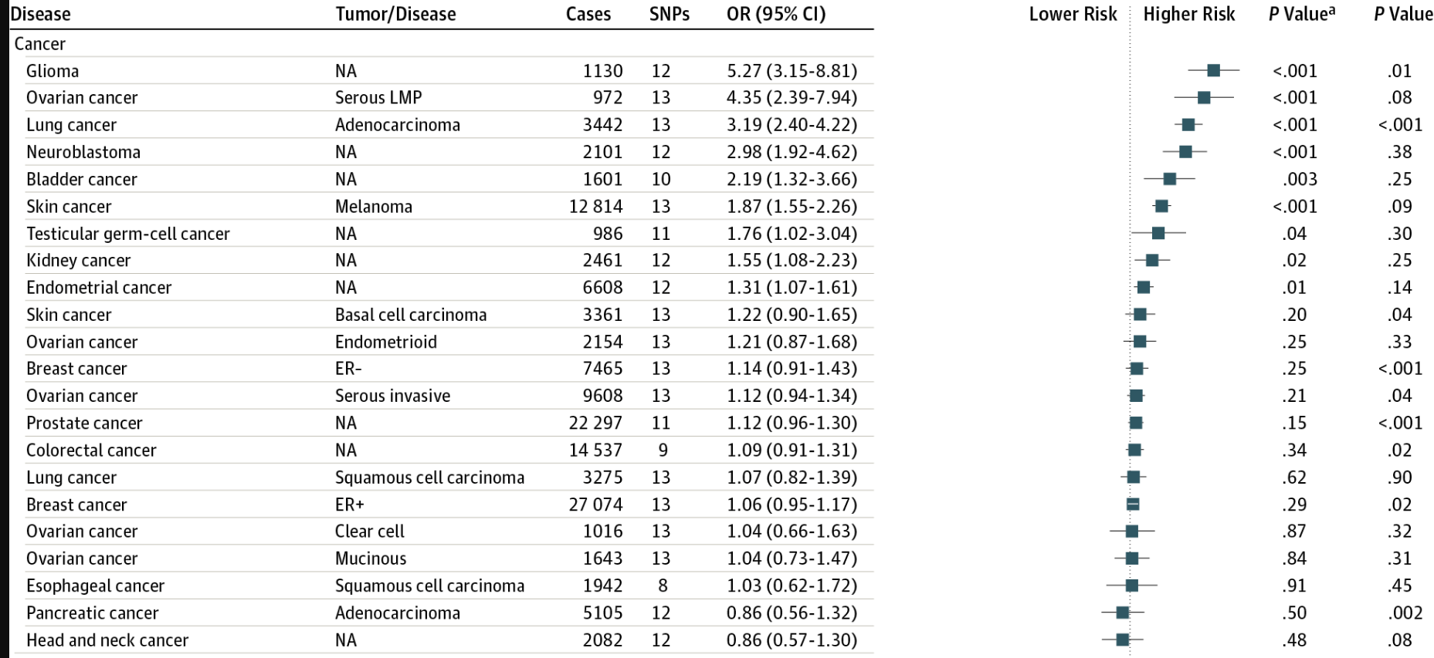

Slide 25
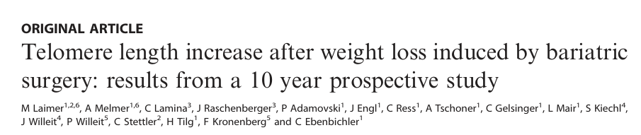
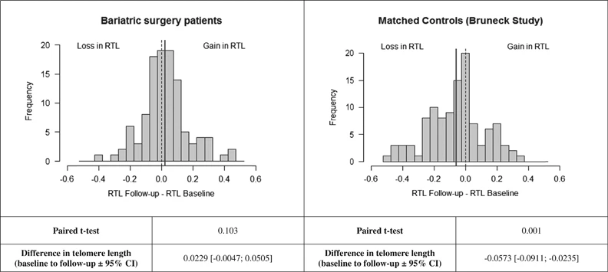

Slide 26
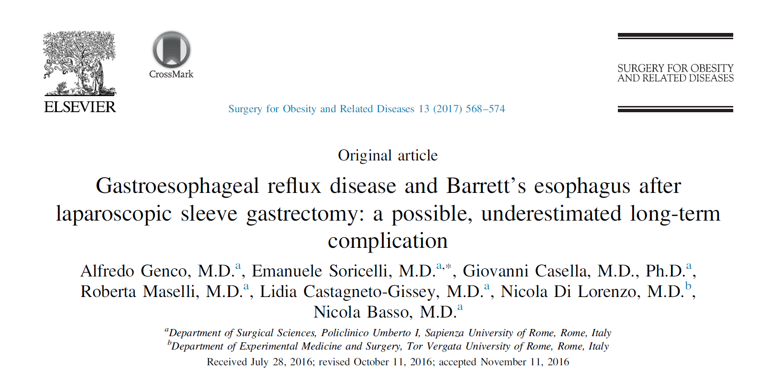
“…At EGD, an upward migration of the “Z” line and a biliary-like esophageal reﬂux was found in 73.6% and 74.5% of cases, respectively
A signiﬁcant increase in the incidence and in the severity of erosive esophagitis (EE) was evidenced, whereas nondysplastic Barrett’s esophagus (BE) was newly diagnosed in 19 patients (17.2%)
No signiﬁcant correlations were found between GERD symptoms and endoscopic ﬁndings…”

Slide 27
GERD IS A CHRONIC PROGRESSIVE DISEASE
Acid exposure
Bile exposure
2-16 YEARS
Lord RVN, DeMeester SR, Peters JH, Hagen JA, Elyssnia D, Sheth CT, DeMeester TR
Hiatal Hernia, Lower Esophageal Sphincter Incompetence, and Effectiveness of Nissen Fundoplication in the Spectrum of Gastroesophageal Reflux Disease
J Gastrointest Surg (2009) 13:602–610
Notes:
27

Slide 28
“…where are they all..?!...” Fermi paradox!

Slide 30
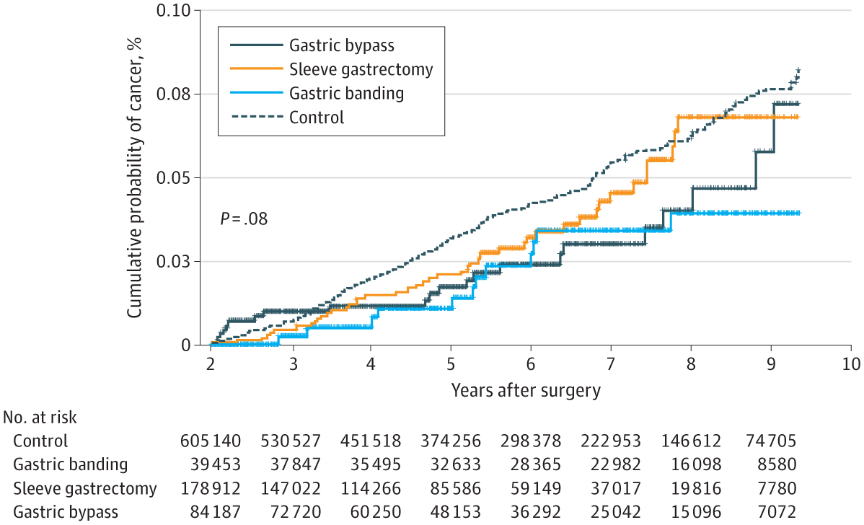

Slide 31
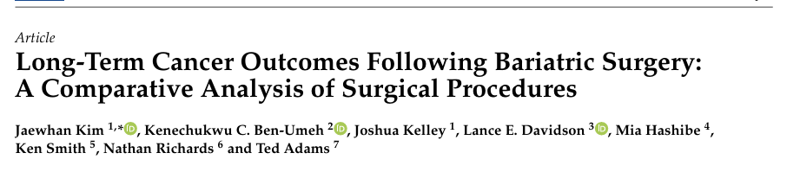
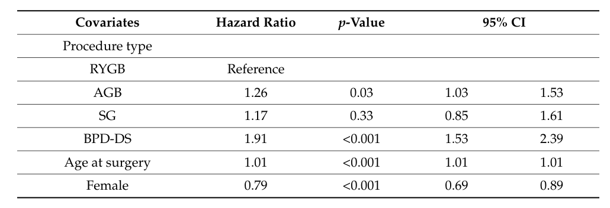

Slide 32
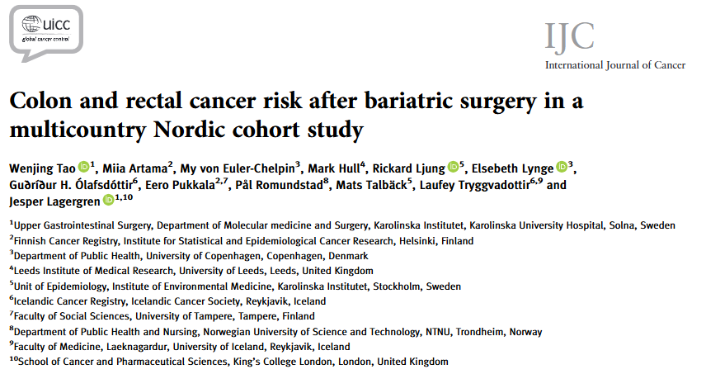
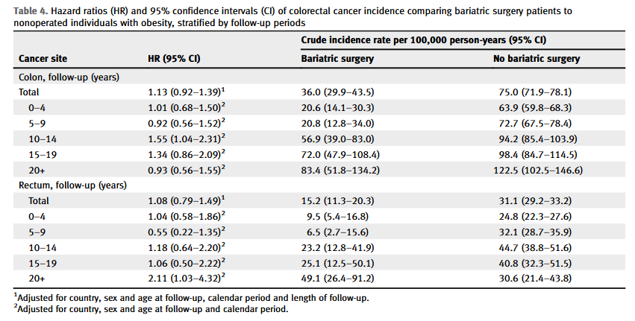

Slide 33
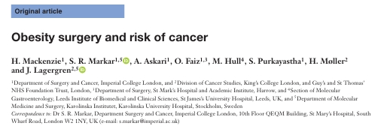
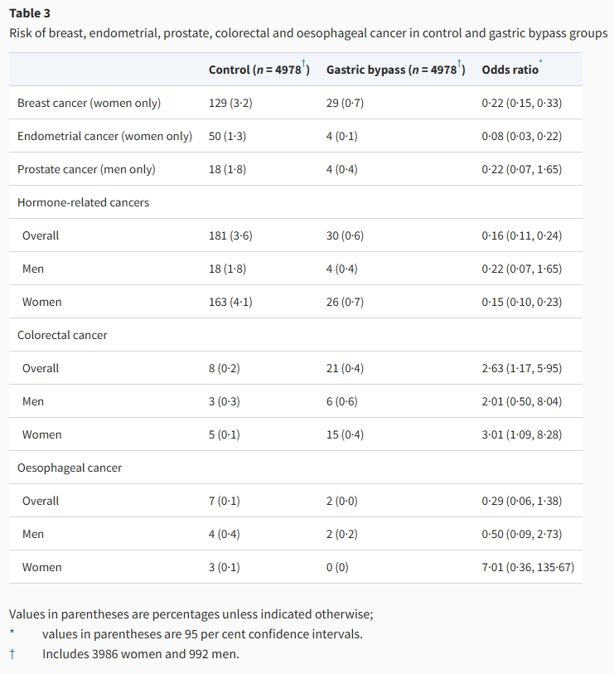
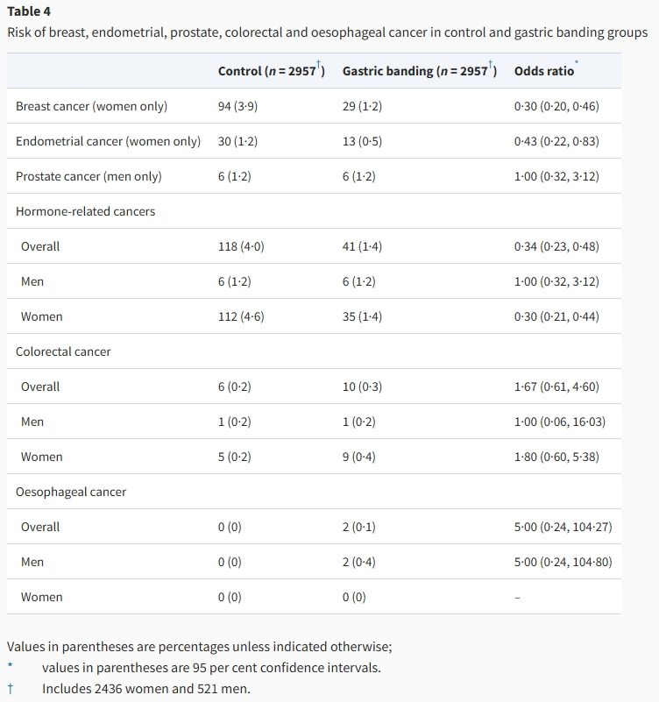
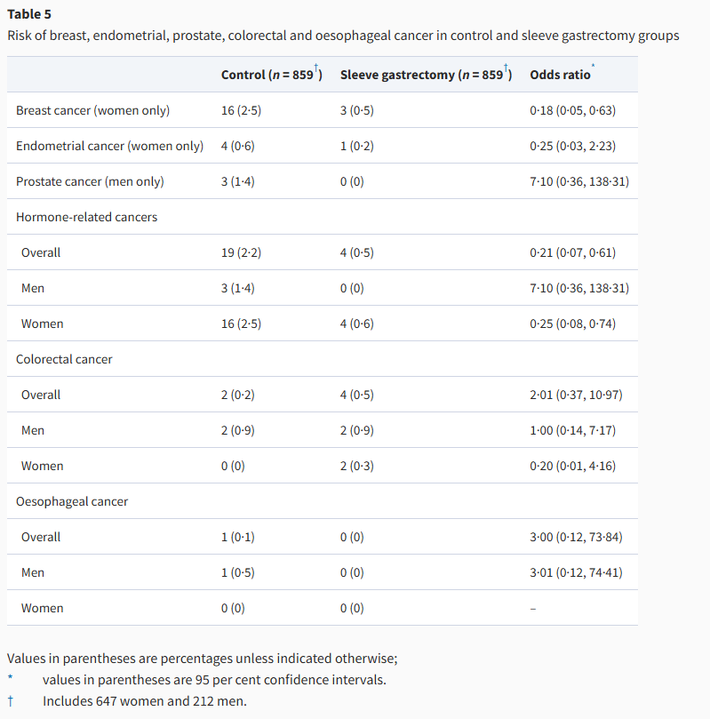

Slide 34
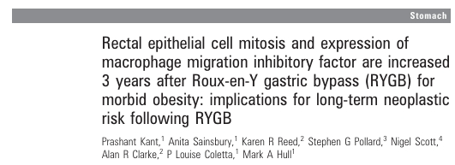

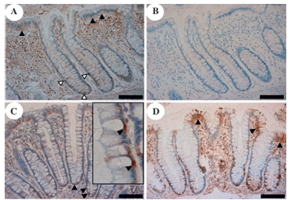
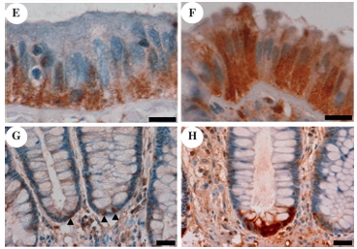

Slide 35
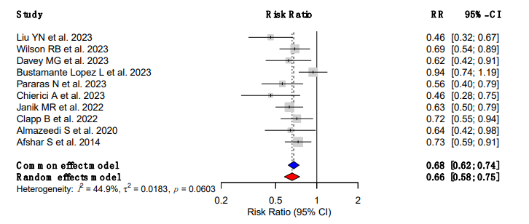

Slide 37
Conclusions
Several mechanisms are responsible for the increased risk of cancer in patients with obesity
MBS clearly reduces the risk of most obesity-associated cancers
This happens despite the increase of certain pre-neoplastic lesions (e.g., BE, increased epithelial proliferation after RYGB)

Slide 38
Thank you for your attention!
​
​
francesco.papadia@unige.it

